Slide 1

PREDICTING THE FOOTFALL IN RESTAURANTS
ASSIGNMENT 2 – Adaptive business intelligence
MANASVI TYAGI - 1525972
MANASH KRISHNA DAS - 1534721

Slide 2

THE BUSINESS PROBLEM?
In the restaurant business, the biggest challenge is to predict the number of customers in a single day.
The goal is to predict the possible footfall in the future with the help of past data.

Slide 3

IMPORTANCE
If we could accurately predict the footfall
Appropriate measures could be taken to meet the rising demands. E.g. Hiring extra employees, increase the raw material for the day.
The owner can safely determine the amount of capital investment with respect to the prediction.
Business decisions could be made in case of a decline in customers.
All in all, the financial loss that the owner incurs will be minimized.
-------------------------------------------------------

Slide 4

IMPACT
If the footfall can be predicted, then the food wastage could be substantially reduced.
If the additional loss incurred due to factors related to footfall is minimized, the job security and incentives of employees increases.

Slide 5

METHODS USED
Time Series Forecasting
ARIMA
Holt Winters

Slide 6

DATASET
The dataset used was taken from Kaggle which includes 8 distinct datasets.
The records in these datasets were collected from 2 separate sources.
The data for training and testing are separate and spans from 2016 to mid-2017.
. In brief, the 8 datasets include
•Past footfall data (Primary training data).
•Bookings made online through source 1.
•Bookings made online through source 2.
•Location and genre of the restaurants from source 1.
•Location and genre of the restaurants from source 2.
•Store ID’s
•Special dates like holidays.
•Test data.
-------------------------------------------------------------------------------------------------

Slide 7

TECHNOLOGY REVIEW

Slide 8
TIME SERIES
Why Time Series?
When we have predictions that depend on time, i.e., absence of time factor will render the prediction redundant, Time Series Forecasting can be implemented.
How it works?
The way Time Series forecasting works is that it evaluates and analyses the past data in order to predict the likelihood of an event in a given time in future.

Slide 9
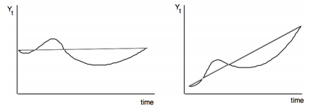
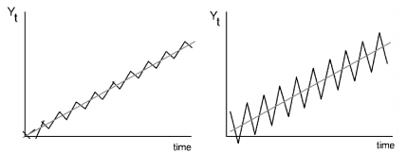
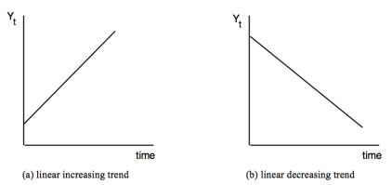
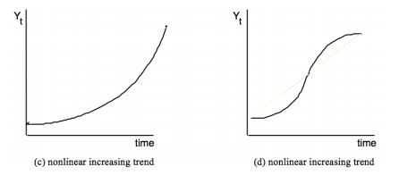
Components of Time Series
Trend - This represents gradual changes in the series over a long time. It can either show a growth or decline.
Cycle – The variations in the data like curves over a long time.
Seasonal – Patterns that occur on specific times.
Noise/Error – No specific conclusions can be observed.

Slide 10
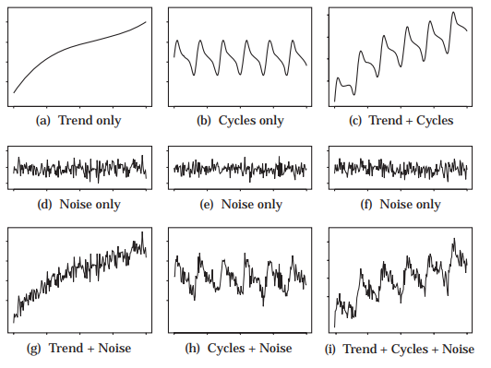
Combination of the Trend Cycle and Noise ----------------

Slide 11
Steps in Time Series Forecasting
•The Definition of the problem
01
•Data and Information Gathering
02
•EDA and Evaluation of the data
03
•Model Creation
04
•Prediction sand forecasting is done using the model
05
•The accuracy is evaluated
06

Slide 12
Methods in Time Series ------------
Regression Based - One can create a time index variable where the observations range from the first one to the last one and develop linear, polynomial or exponential models. This is applicable when the there is a trend but not feasible for seasonality. But one can use linear regression if the data shows seasonality by creating variables that interpret those seasons.
Smoothing Methods - While Regression based model worked best on trends, smoothing methods are more adaptive when it comes to variations or changes in data. It does so by averaging the observations and reducing noise over a period.

Slide 13
Advantages of Time Series
When it comes to data that is represented with respect to time, time series forecasting is the most effective method for prediction and analysis compared to others.
The suitability of defining a custom time interval in terms of days, hours, months, years is ideal and is much needed in cases where the parameters have changed over a period.
It has the ability to predict both financial and endogenous growth. Here endogenous growth refers to the development of an organization from within in terms of human resources and other factors.
When it comes to temporal effects in the data like effect of passage of time, time series is the best option.

Slide 14
DISADVANTAGES OF TIME SERIES
The process of creating a model can sometimes be difficult given that the type of data, i.e., trend, seasonal, cycle or noise. The efficiency of the models is highly dependent on the information and data type.
In some cases, where the data does not have any notable spike or variations, the model may still return a prediction which will be wrong but failing to understand this may lead to making the wrong decision.
Most businesses do not possess or cannot maintain such huge data that span over years.

Slide 15
Limitations Of Time Series --------------
Time series forecasting or analysis is only ideal when we are dealing with data that has significance with respect to time. If the data is independent of time or if the time stamp of the data is same, time series cannot be applied.
If there is any kind of irregularity or discrepancy in the past or present data, the prediction will be inaccurate. For Time Series to work, the data must be perfect and unaltered.
When there are numerous outliers in the data, the prediction will not be accurate, and the evaluation time will be indefinite in some cases.

Slide 16

Models In Time Series Forecasting

Slide 17
Single Moving Average
The Simplest Model.
It assumes that the value in the future is simple and average of the past value, in a single period of time.
. This observation is further divided into a number of subdivisions, based on time. Observation from a single division is then averaged and is considered as a forecast of the future.
As we move in future a number of more data is added and thus becomes another division, or period, which is then averaged, and therefore creating a moving average. This method is most suitable when a variable to be forecasted.

Slide 18
Exponential Smoothing
It is an advanced version of Moving average
The underlying principle of exponential smoothing is to apply weights to the forecasted values such that the recent values are given more weights, and as we go further in the past, the weights are decreased exponentially.
Recent past is more important than further past.
The exponential functions whose exponent factor is called Alpha α, is used to assign weights to the values of the past and then the average is taken. This smoothens the time series and hence the name exponential smoothing.

Slide 19
Why can't we use Simple Moving Average or Exponential Smoothing?
For restaurant visit forecasting this is a simplistic method, and we need to note that both Exponential smoothing and moving average are univariate time series
In case of a real-world business problem several factors would be ideally responsible and hence these are not a good choice for our problem
Also, it cannot be used when there is trend and seasonality in the data.

Slide 20

What Can we USE?

Slide 21
ARIMA
It stands for Auto Regressive Integrated Moving Average
It is based on the autocorrelation in the data
ARIMA is mostly used when there is non-stationary data
We difference the time series in order to make the series stationery, and then combine the Auto Regressive as well as Moving Average techniques. Additionally, we do a step called Integration.
In R ‘forecast’ and ‘tseries’ package is required for using ARIMA Modelling

Slide 22
Holt Winters
It employs exponential smoothing method to encode values of the past and uses it to forecast “typical” values. It is based on the autocorrelation in the data
Holt-Winters is a method of modelling 3 factors of the time-series:
Typical value (basically average)
Trend over time
Cyclical pattern (seasonality)
Since it uses these three aspects, hence it is called triple smoothing method
The model asks for many parameters for each smoothing (ɑ, β, γ), the size of a typical season, and the number of periods within each season.
The most important part in Holt-Winters is to use selecting these three parameters (trend, values and seasonality) for accurate forecasting.

Slide 23
Why Use These Models?
The data as explored in EDA stage shows that there is a seasonality, although we do not know the season period.
It is seen that there is a trend in our data, because for visitors each genre of food the mean values range between 10 and 100 visitors
For Example, in each of the category, long-term trend looks stable. There is an upward trend in "Okonomiyaki" and "Creative Cuisine, while the popularity of "Asian" genre is seen to be declining from 2016.

Slide 24
Solution Design and Development
The primary goal of this project is prediction, but for that to take place, we must have a firm understanding of the variables that are contributing to that prediction
That includes a thorough exploratory data analysis through which we can quantify the extent of influence that each parameter has over the data and the relation between the features

Slide 25
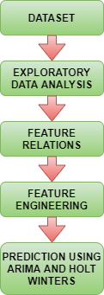
STEPS in Brief

Slide 26

Let's Zoom In

Slide 27
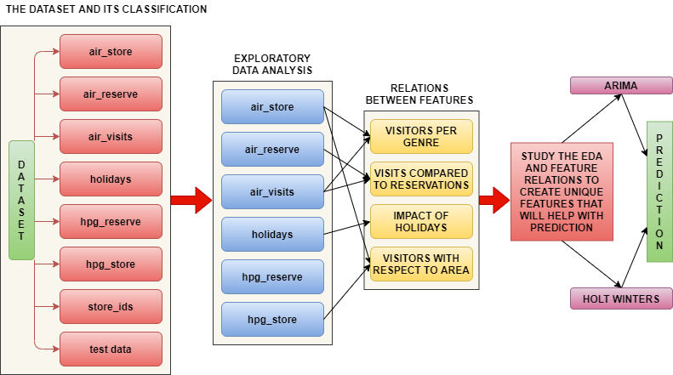
STEPS in Detail

Slide 28
Programming Language and Platform
The project was made using the programming language
RStudio was used as a platform to code the project.

Slide 29
Libraries used
Function | Libraries | Purpose in Project
Visualization | ggplot2 | Basic library for creating plots.
 | scales | For automatically making breaks and labels for legends and axes.
 | grid | Add Details using ridges in feature relations.
 | gridextra | For arranging numerous grids in a single page.
 | rcolorbrewer | Extend the color palette for visualization.
 | corrplot | Universal use for finding correlation between features. Has been used multiple times during EDA in this project.
Data Manipulation | dplyr | General dataset manipulation library.
 | data.table | For faster aggregation of data.
Input/Output | readr | In this case, to read csv files.
Data Wrangling | tidyr | Make the data tidy
String Manipulation | stringr | Feasibility in using string functions
Factor Manipulation | forcats | Handling and modifying variables. Used when playing with EDA and changing each parameter to look at results.
Specific Visualization | ggrepel | Geoms for ggplot2.
 | ggextra | Used ggMarginal function to plot histogram in reservation vs visits.
 | ggforce | Facet zoom view used for relation between mean visitors and time slope.
 | viridis | Color package.

Slide 30

Exploratory Data Analysis

Slide 31
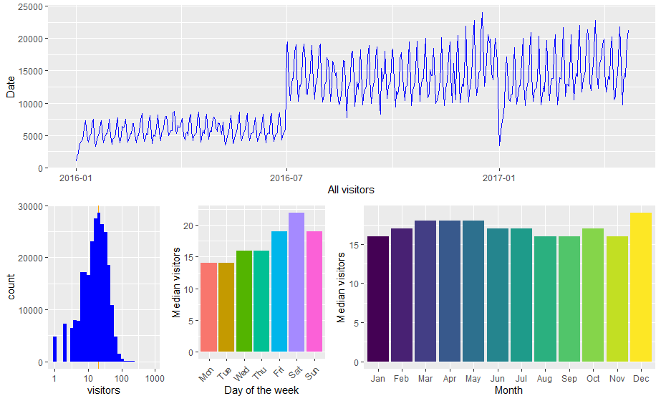
Visits in each Store

Slide 32
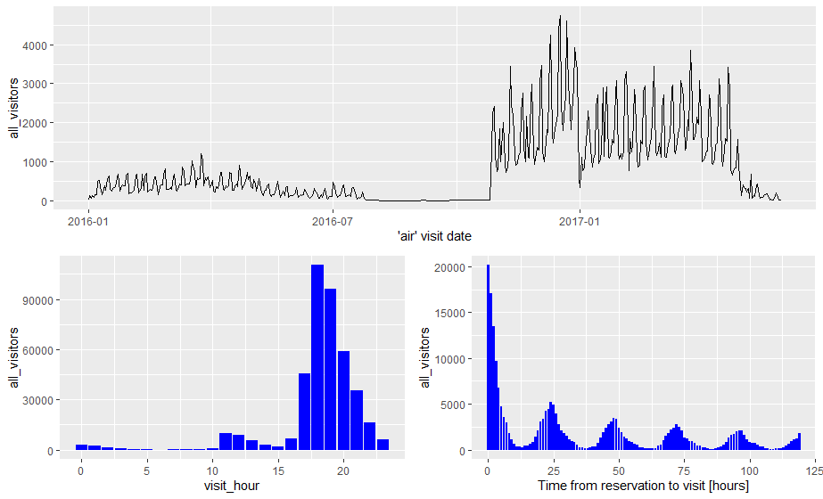
Reservations vs Visits

Slide 33
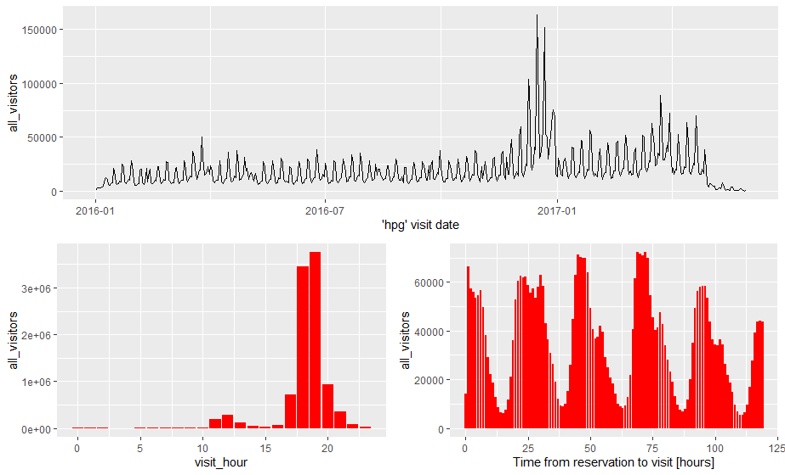
hpg reservation data

Slide 34
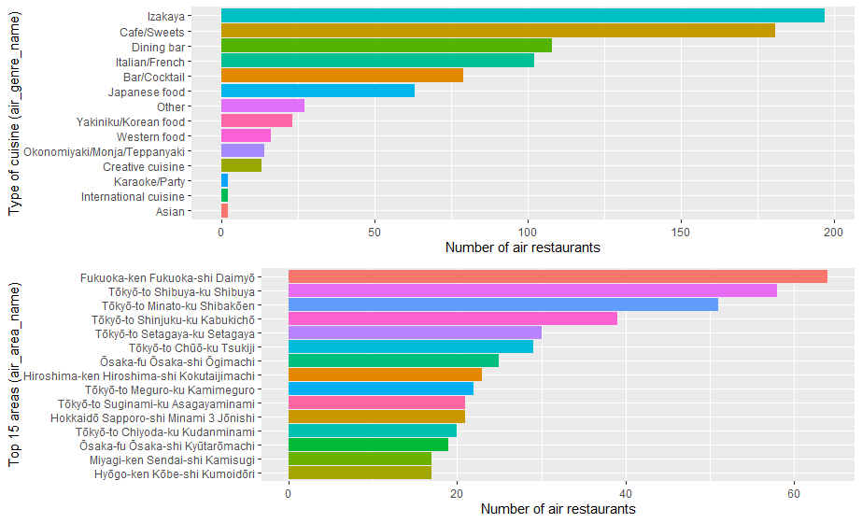
Classification with respect to genre

Slide 35
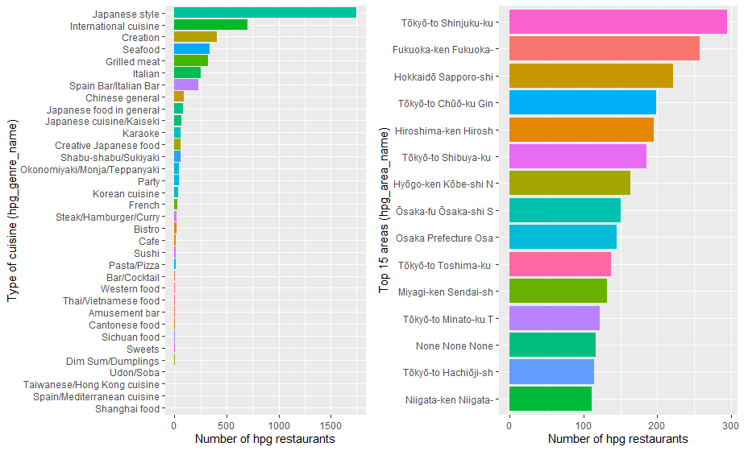
hpg restaurant genres and their frequency

Slide 36
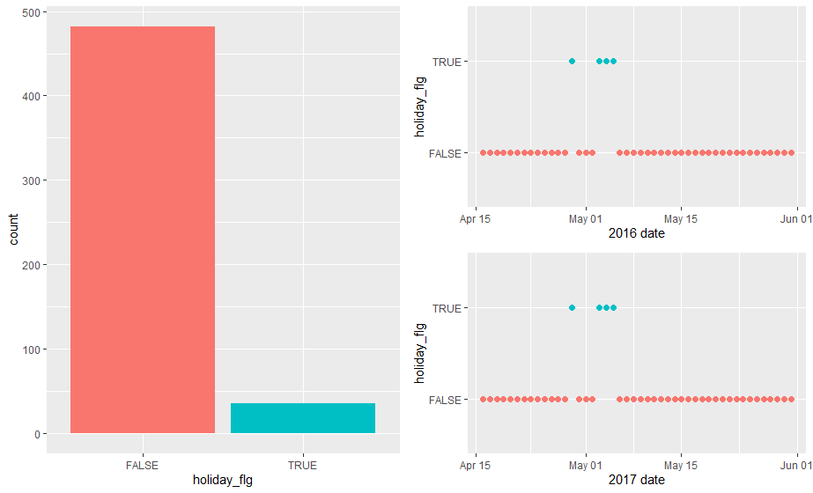
Holiday Data

Slide 37
Relation Between Features

Slide 38
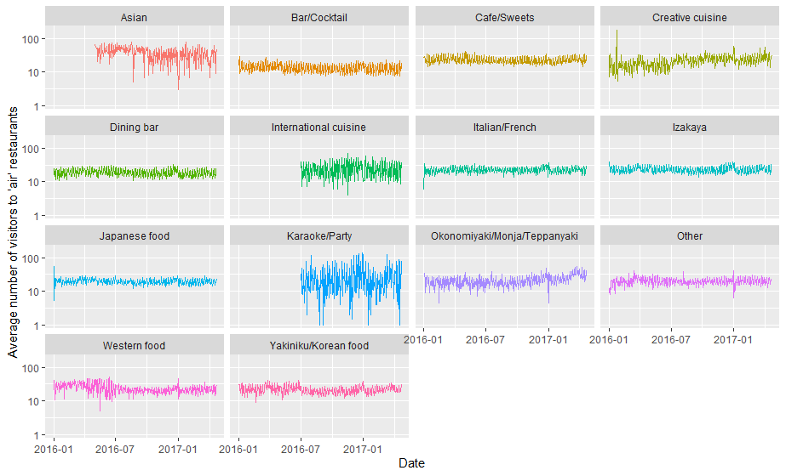
Visitors with respect to cuisine

Slide 39
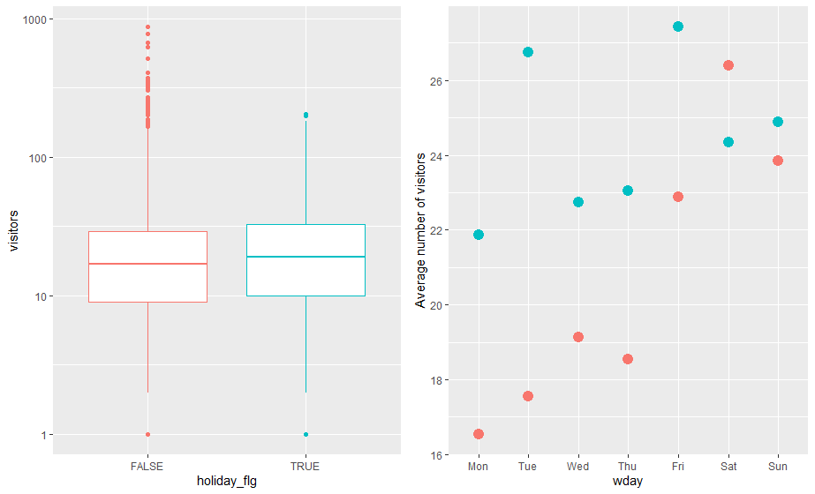
Effect of Holidays

Slide 40
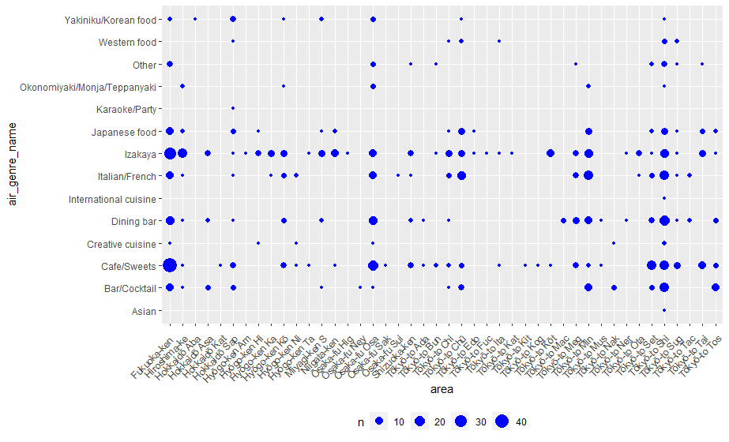
Visitors with respect to area in air

Slide 41
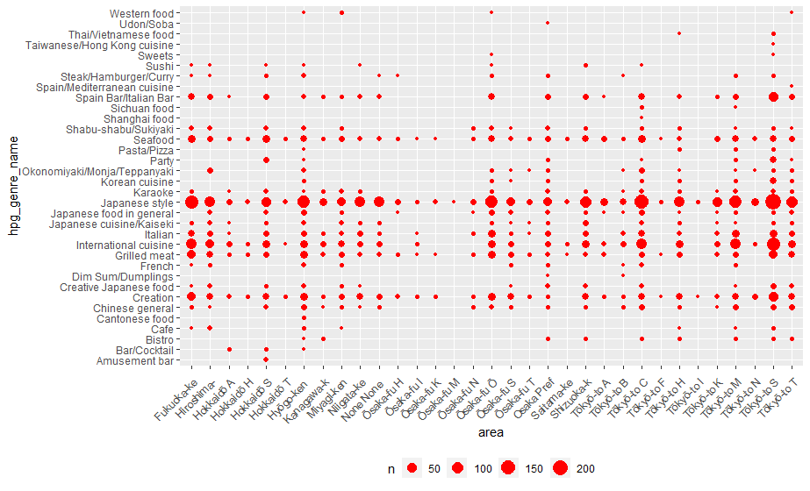
Visitors with respect to area in hpg

Slide 42
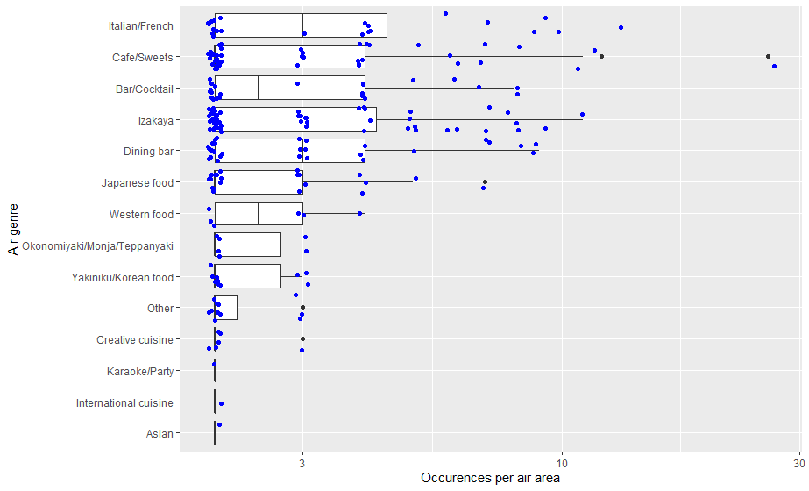
Cuisine and its count in each area

Slide 43
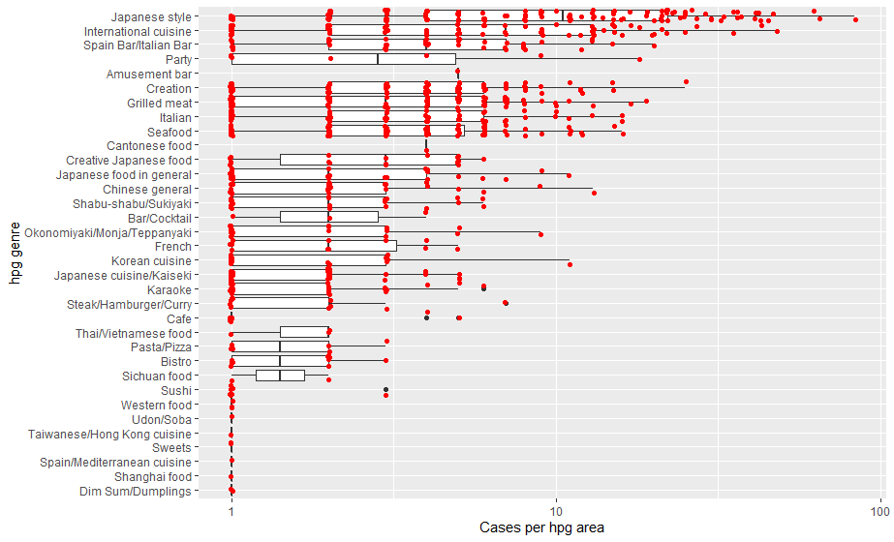
Occurrence per hpg area

Slide 44
Features Engineering

Slide 45
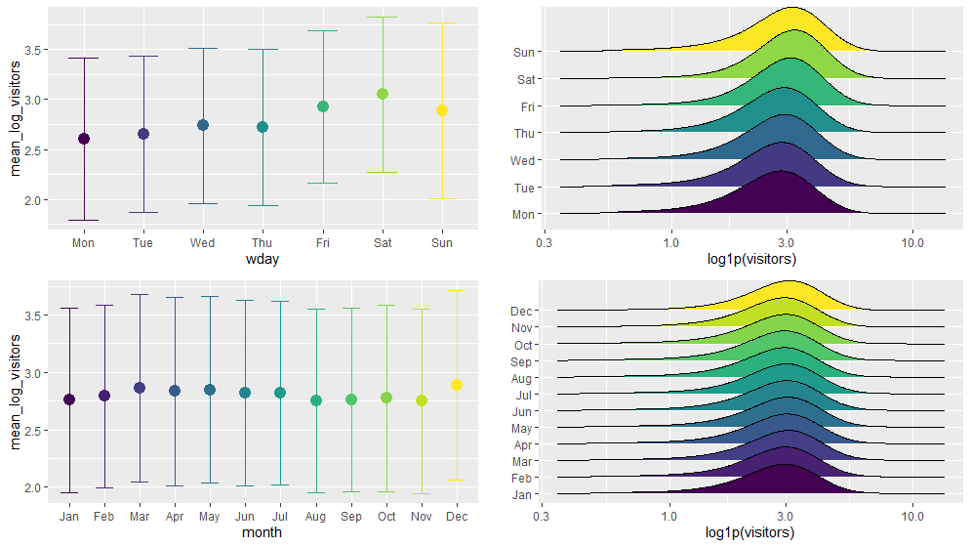
Days of the week & months of the year

Slide 46
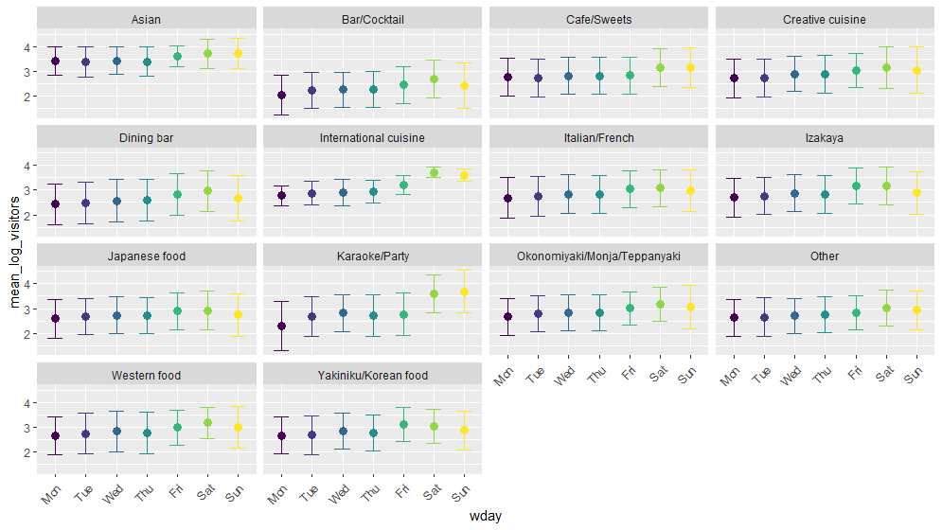
Breakdown according to Cuisine

Slide 47
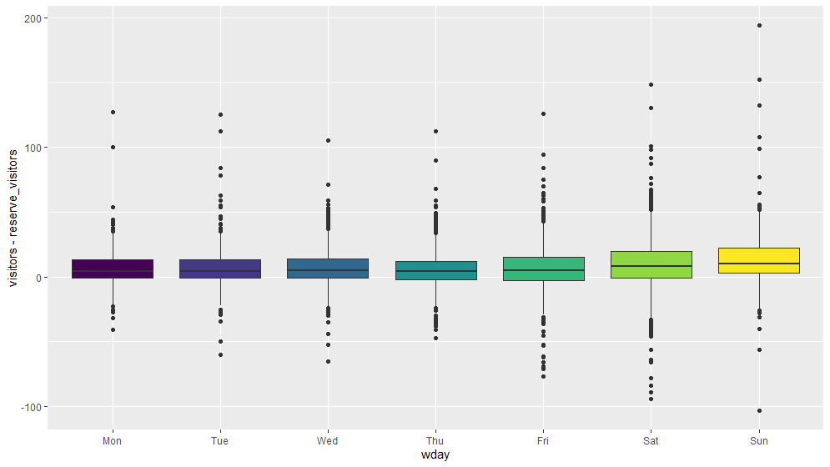
Visits vs Reservations according to the day of the week

Slide 48
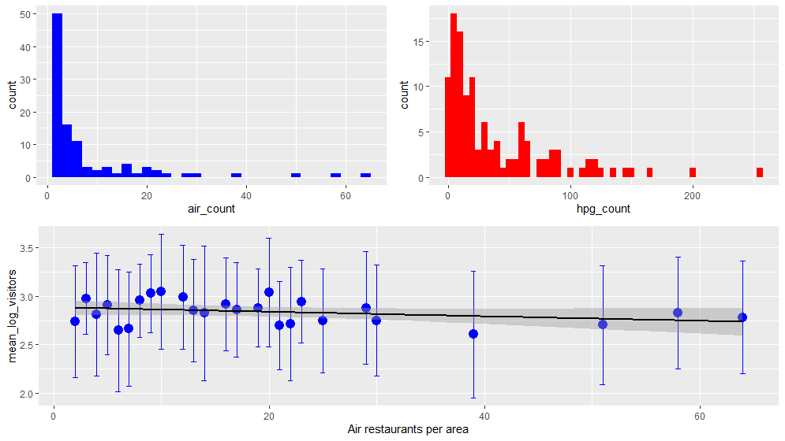
Restaurant per area for both sources

Slide 49
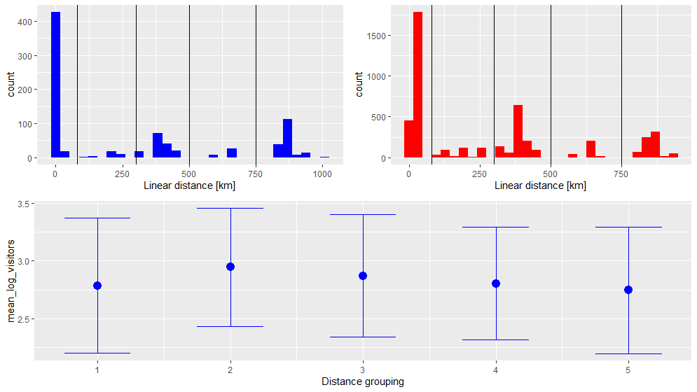
Distance from the busiest area

Slide 50

Finally… PREDICTION

Slide 51
How Results are achieved - ARIMA
General methodology is to divide the data into training data as well as test data. In this case the test data against which we shall compare our predicted results is 39 days
Auto-regressive factor is P
Integrated or differencing factor is d
Moving Average factor is q
We use auto.arima tool in R, which estimates these parameters
Goal is to predict traffic during Apr 23rd - May 31st as ‘prediction length’

Slide 52
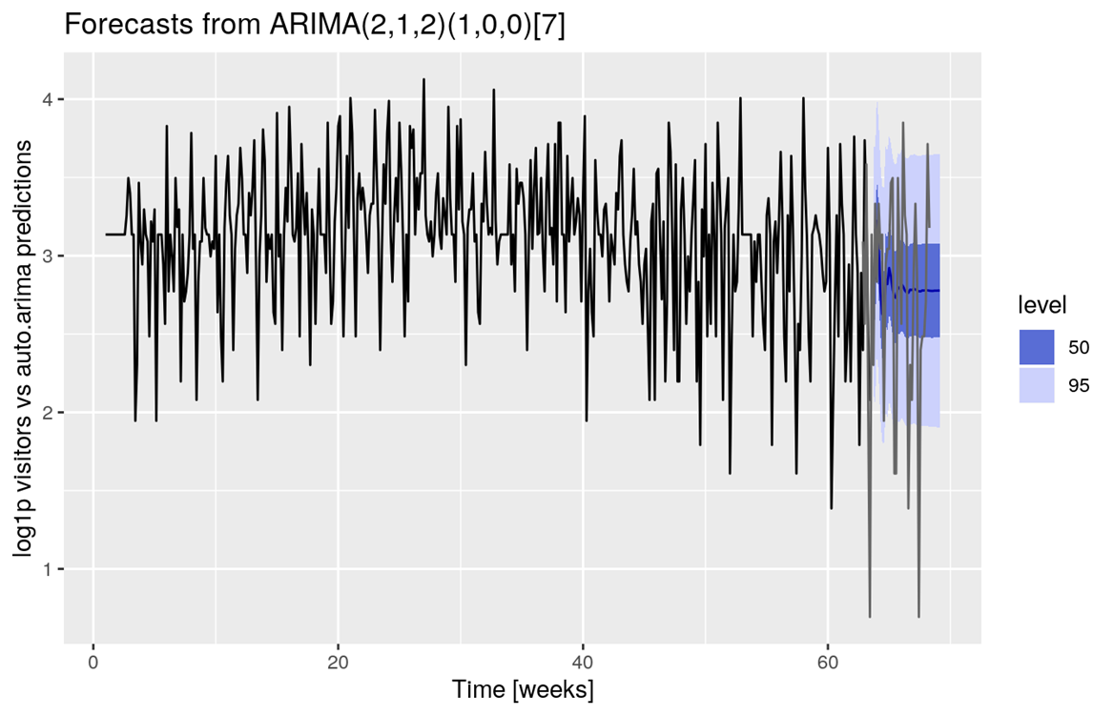
Results- ARIMA
Dark Blue line represents the Predicted output
While shading represents the Confidence interval
Disadvantage
Large spikes are not captured

Slide 53
How Results are achieved – Holt Winters
From the stats Package of R we use Holt –winter function
Exponential smoothing method which takes care of trend in the data
Although it is not straightforward to determine that the there is a definite trend in the data.
Moving Average is also used in Holt-Winters
It is suitable where there is seasonality in the data.
Three most important factors are Alpha, Beta & Gamma
α -> Base Level
β -> Trend Factor
γ -> Seasonality Factor
Again Goal is to predict traffic during Apr 23rd - May 31st as prediction length

Slide 54
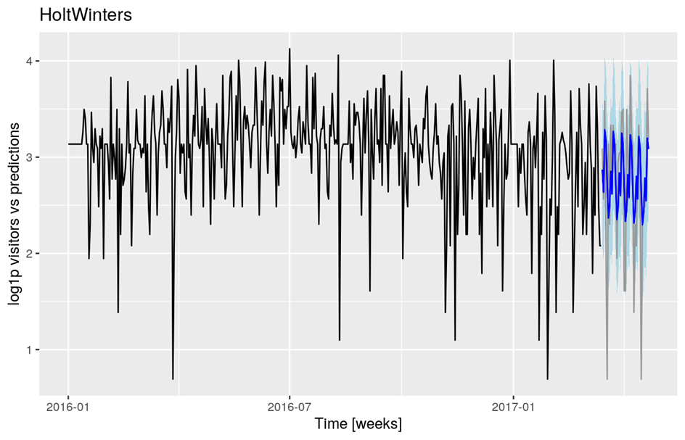
Results - Holt Winters
Dark Blue line represents the Predicted output
While shading represents the Confidence interval > 0.95
Advantage:
As we can visually inspect, Holt winters performs better than ARIMA since the spikes are also captured.

Slide 55
Challenges
32 packages are used, and hence it takes long time just for installation
Missing the steps of not removing NA values, led to non conclusive predictions
Before choosing the correct time series model, we spent a lot of time just exploring the data, for which we needed to develop an intuition based on visual inspection.
It was a challenge to learn the different kinds of analysis and use it in the project at the same time.

Slide 56
Thank You Everyone

Slide 57
Thank You Natt

